Slide 1
Chapter V
Discrete-Time Frequency Domain Methods

Slide 2
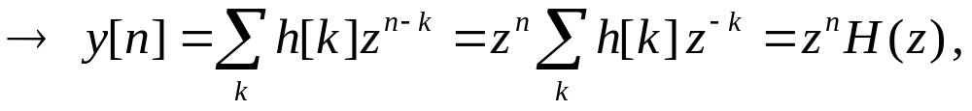
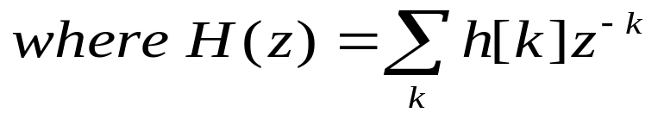
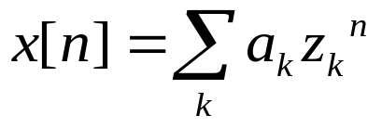
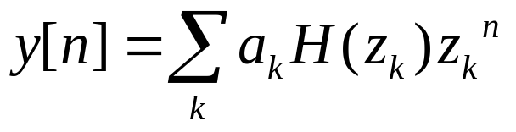
Fourier Series Representation of DT Periodic Signals
Let x[n] = z^{n} be the input to DT system with h[n] (z is a complex number)
→ Response of LTI, DT system to z^{n} is of the same type
→ z^{n} : eigenfunction of LTI DT system
→ H(z) : eigenvalue of LTI DT system
If
the
input
can
be
represented
as
then
the
output
is

Slide 3

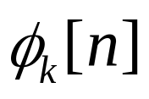
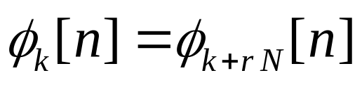

Fourier Series Representation of DT Periodic Signals
Recall:
are periodic with N and have fundamental frequencies that are multiples of (harmonically related ).
→ There are only N distinct signals in
as DT comp. exp. which differ in freq. by a multiple of are identical.

Slide 4
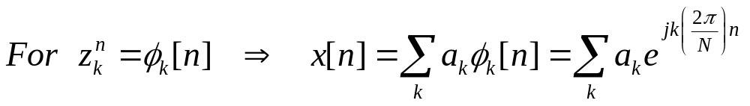
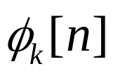
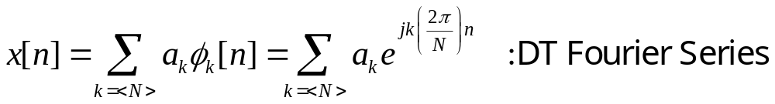
Fourier Series Representation of DT Periodic Signals
As is distinct only over N successive values of k:
k could take values k=0, 1, ..., N-1 or k=3, 4, ..., N+2

Slide 5
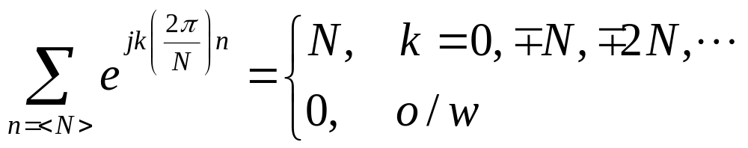
Fourier Series Representation of DT Periodic Signals
Assume x[n] is periodic with N, how to find a_{k}?
Similar to CT case, we use the relation:
(Sum over one period of the values of a periodic complex exponential is zero unless the comp. exp. is a constant)

Slide 6
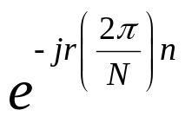
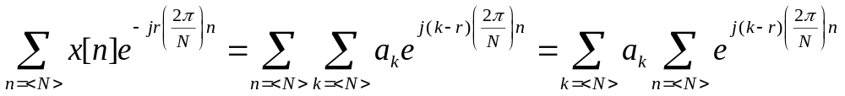
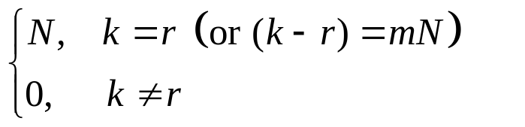
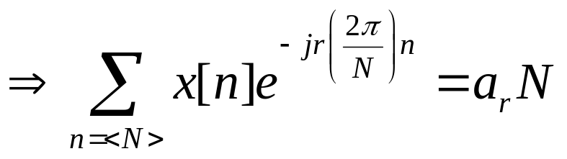
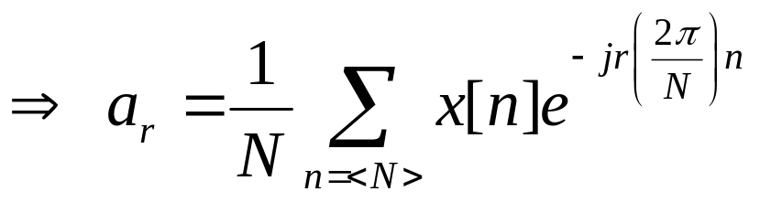
Fourier Series Representation of DT Periodic Signals
Multiply both sides of DTFS by and sum over N terms:
m is an integer, and here we choose values for r over the same range as that over which k varies (k=<N> in the outer summation), Therefore, for k=r, the innermost sum is N, and for k≠r it is 0.

Slide 7
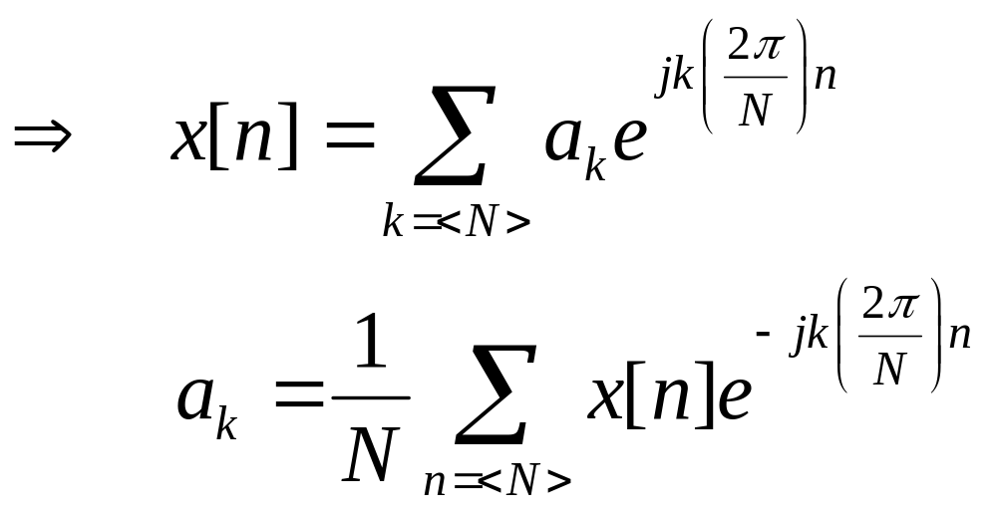
Fourier Series Representation of DT Periodic Signals
Synthesis Equation
DTFS Pairs
Analysis Equation
Spectral Coefficients
No convergence issue!
Note that a_{k} = a_{k+N} : DTFS coefficients are PERIODIC !

Slide 8
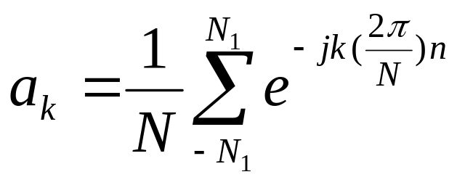
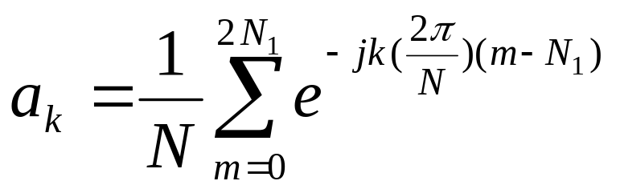
Fourier Series Representation of DT Periodic Signals
Example:
Consider DT periodic square-wave with period N.
1
- - -
- - -
-N
-N₁
0
N₁
N
n
For m=n+N₁

Slide 9
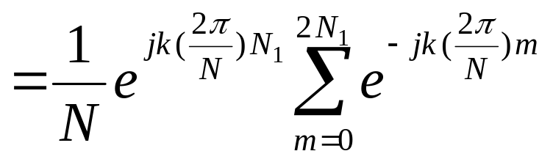
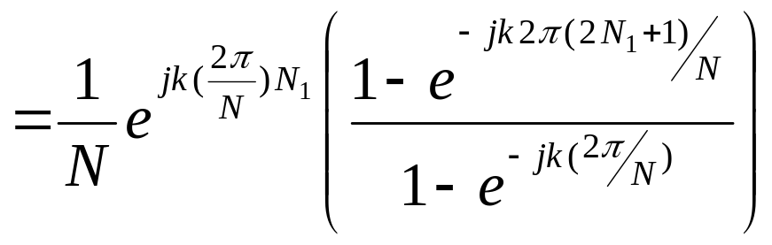
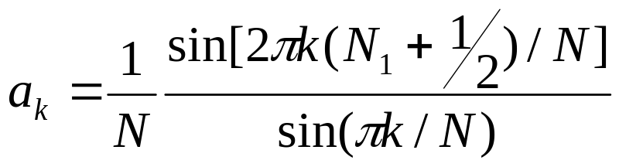

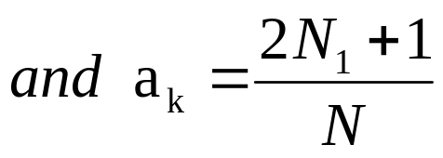

Fourier Series Representation of DT Periodic Signals

Slide 10



Discrete Time Fourier Transform
Consider an aperiodic finite duration sequence x[n]
n
-N₁
N₂
Construct a periodic sequence for which is one period
n
-N
-N₁
N₂
N
such that as for any finite n.

Slide 11
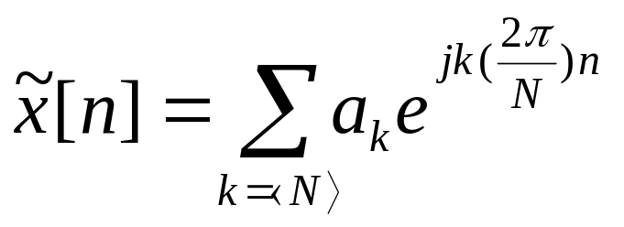
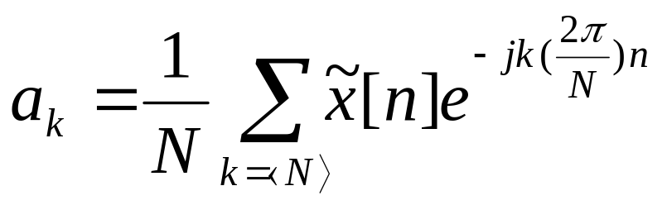
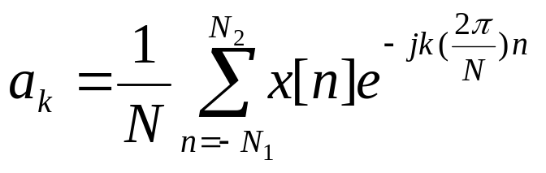
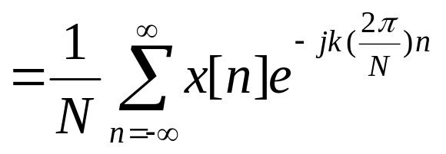
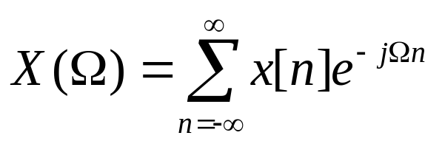
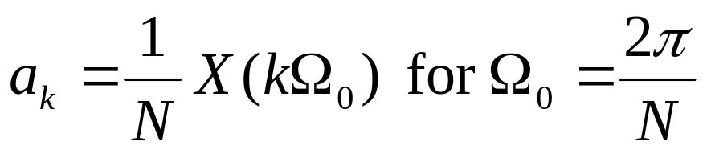
Discrete Time Fourier Transform
;
DTFS of periodic signal
Define

Slide 12
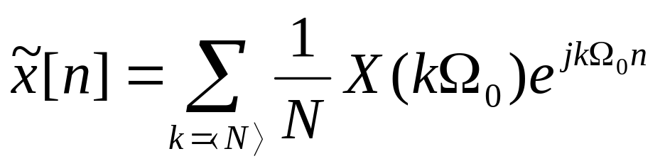
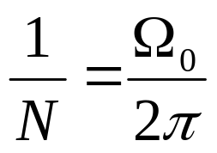
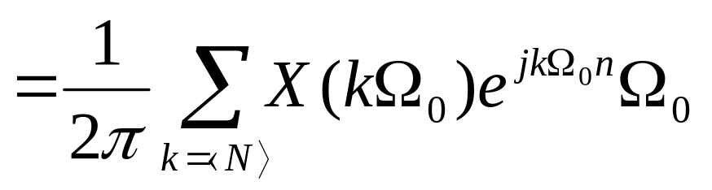
Discrete Time Fourier Transform
as

Slide 13
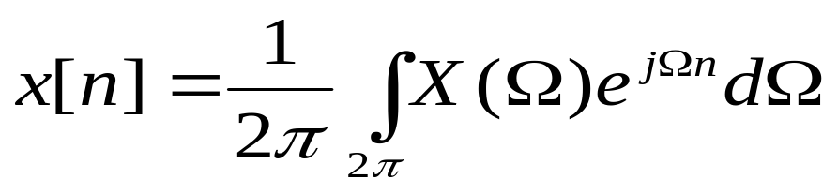
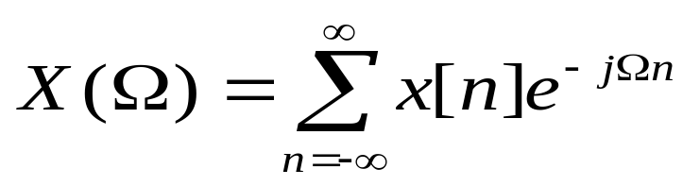
Discrete Time Fourier Transform
DTFT pairs
X(Ω) is periodic with 2π
how an aperiodic sequence can be thought of as a linear combination of complex exponentials!
X(Ω) at Ω=0 and Ω=2π are same!
around Ω=0, 2π low frequency
around Ω=π high frequency

Slide 14
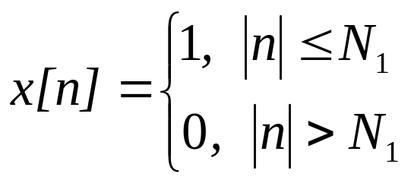
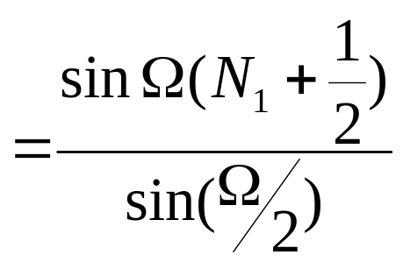
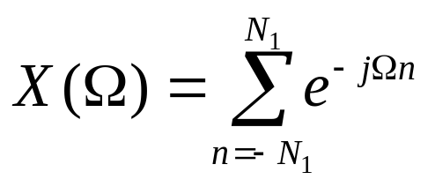
Discrete Time Fourier Transform
Example:
Consider the rectangular pulse
n
-N₁
0
N₁

Slide 15
Discrete Time Fourier Transform
Example:
Consider the rectangular pulse
n
-N₁
0
N₁
5
X(Ω)
For N₁=2
Ω
-2π
-π
0
π
2π
X(Ω) is periodic with 2π !

Slide 16
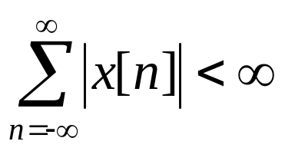
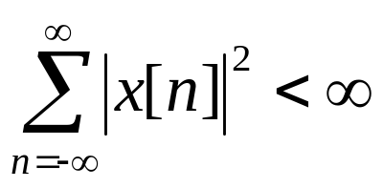
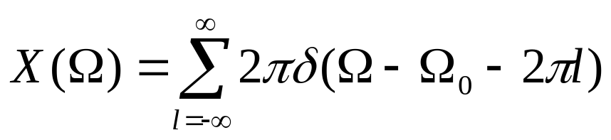
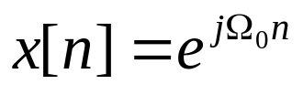
Convergence of DT Fourier Transform
DTFT exists if
or
No convergence issue as the inverse integral is evaluated over finite interval.
Check this by evaluating
the inverse DTFT
DTFT for Periodic Signals :
Consider the signal
(DTFT is periodic with 2π)
X(Ω)
2π
- - -
- - -
Ω₀-4π
Ω₀-2π
Ω₀-2
Ω₀
Ω₀+2π
Ω₀+4π
Ω

Slide 17
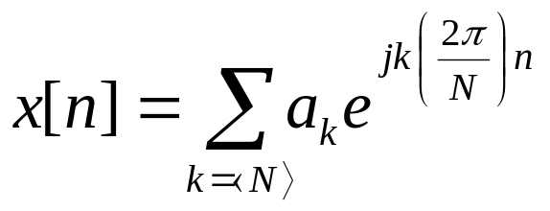
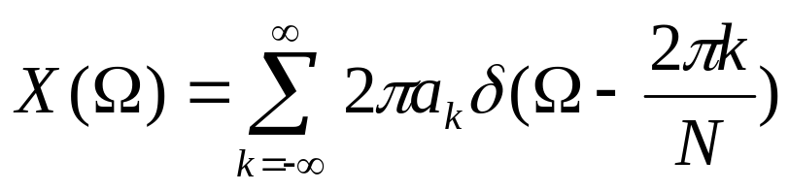
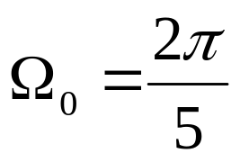
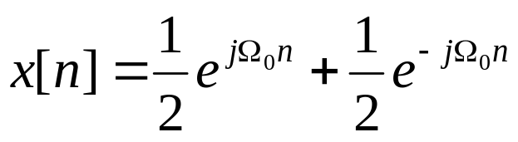
Convergence of DT Fourier Transform
Consider
: DTFT of periodic signal
(verify as an exercise!)
Example :
Consider x[n]=cosΩ₀n with

Slide 18
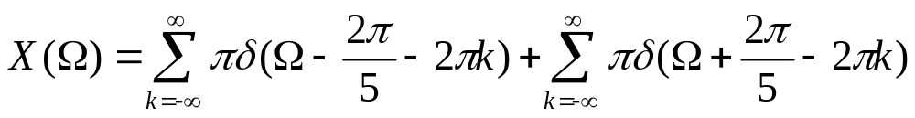
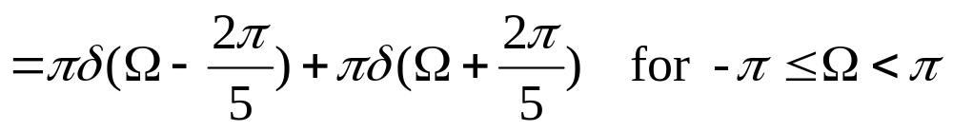
Convergence of DT Fourier Transform
X(Ω)
π
-2π-Ω₀
-2π
-2π+Ω₀
-Ω₀
Ω₀
2π-Ω₀
2π
2π+Ω₀
Ω
X(Ω) is periodic with 2π.

Slide 19
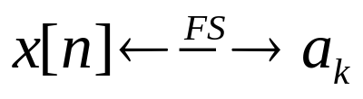
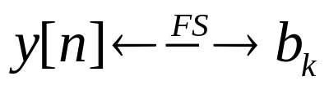
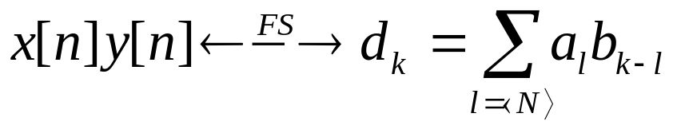
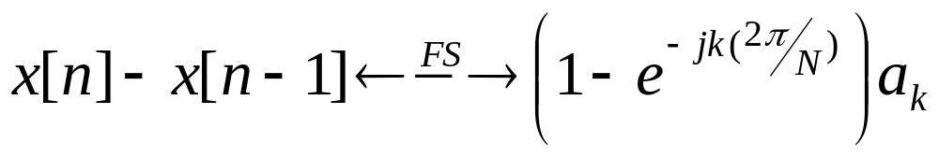
Properties of DT Fourier Series
Notation:
1. Multiplication:
if
and
, then
(periodic convolution!)
Solve problem 3.46 from Oppenheim.
2. First Difference:
, then
if

Slide 20

Properties of DT Fourier Series
3. Parseval’s Relation:
average power in k^{th} harmonic
average power in one period for periodic signal x[n]
Study and show the basic properties of DTFS on Table 3.2 @ Oppenheim

Slide 21





Properties of DT Fourier Transform
Notation:
1. Periodicity:
: DTFT is always periodic with period 2π
2. Time Shifting and Frequency Shifting:
if
, then
(time shifting)
(frequency shifting)

Slide 22





Properties of DT Fourier Transform
3. Conjugation / Conjugate Symmetry:
if
, then
if x[n] is real,
4. Differencing / Accumulation:
if
, then
(show by shifting)

Slide 23




Properties of DT Fourier Transform
5. Time Reversal:
if
6. Time Expansion:
Remember
if x[an] a should be integer.
to slow down the signal a<1 Not possible !
to speed up
e.g. x[2n]
Not really speeding up!
x[2n]: consists of even samples of x[n] only.

Slide 24


Properties of DT Fourier Transform
Let k be a positive integer and define the signal
(insert k-1 zeros between successive values of x[n], hence x_{(k)}[n] is slowed-down version of x[n])
x[n]
x₃[n]
n
n
x_{k}[n]=0 unless n=rk

Slide 25





Properties of DT Fourier Transform
7. Differentiation in Frequency:
if
, then
(multiply both sides with j)

Slide 26

Properties of DT Fourier Transform
8. Parseval’s Relation:
if
, then
energy-density spectrum
total energy in signal x[n]
9. Convolution Property:

Slide 27




Properties of DT Fourier Transform
10. Multiplication Property:
Consider
Since

Slide 28


Properties of DT Fourier Transform
: periodic
convolution

Slide 29


Example 5.6
Find DTFT of the discrete-time periodic impulse train.
x[n]
1
. . .
. . .
n
-N
0
N
2N
The Fourier series coefficients for this signal

Slide 30






Example 5.6
Choosing the interval of summation as 0 ≤ n ≤ (N–1):
The Fourier transform of the signal is represented as
. . .
. . .

Slide 31


Example 5.9
2
x[n]
Consider the following sequence x[n], find its DTFT.
1
0
1
2
3
4
5
6
7
8
9
n
y[n]
This sequence can be related to the simpler sequence y[n] as following:
1
0
1
2
3
4
5
6
7
8
9
n
y₍₂₎[n]
1
where
n
0
1
2
3
4
5
6
7
8
9
2
2y₍₂₎[n-1]
0
1
2
3
4
5
6
7
8
9
n

Slide 32




Example 5.9
Note that y[n]=g[n-2], where g[n] is a rectangular pulse. Consequently, using the time-shifting property:
Using the time-expansion property:
Using the linearity and the time-shifting properties:
Combining these two results:

Slide 33





Example 5.15
Find the Fourier transform of x[n] which is the product of two other signals:
where
and
X(Ω) is the periodic convolution
of X₁(Ω) and X₂(Ω):
We can convert the equation into an ordinary convolution by defining:

Slide 34























Example 5.15
1
1

Slide 35



Example 5.19
Consider a causal LTI system that is characterized by the difference equation given below. Find its impulse response h[n].
The frequency response is

Slide 36



Example 5.19
As a first step in obtaining the impulse response, we factor the denominator of the frequency response.
H(Ω) can be expanded by the method of partial fractions. The result of this expansion is
The inverse transform of each term can be recognized by inspection, with the result that

Slide 37

Problem 3.26
Let x(t) be a periodic signal whose Fourier series coefficients are
Use Fourier series properties to answer the following questions:
(a) Is x(t) real?
(b) Is x(t) even?
(c) Is dx(t)/dt even?

Slide 38


Solution 3.26
(a) If x(t) is real, then x(t)=x*(t). This implies that for x(t) real a_{k}=a*_{-k}. Since this is not true in this case, x(t) is not real.
(b) If x(t) is even, then x(t)=x(-t) and a_{k}=a_{-k}. Since this is true for this case, x(t) is even.
(c)
Therefore,
Since b_{k} is not even, g(t) is not even.

Slide 39


Problem 3.35
Consider a continuous-time LTI system S whose frequency response is
When the input to this system is a signal x(t) with fundamental period T= and Fourier series coefficients a_{k}, it is found that the output y(t) is identical to x(t). For what values of k is it guaranteed that a_{k}=0?

Slide 40
Solution 3.35
The FS coefficients of y(t) are b_{k}=H(jkω₀)a_{k}, where ω₀ is the fundamental frequency of x(t) and a_{k} are the FS coefficients of x(t).
If y(t) is identical to x(t), then b_{k}=a_{k} for all k.
Since H(jω)=1 for |ω|≥250, H(jkω₀)=1 for |k|≥18 (because ω₀=14).
Therefore, a_{k} must be zero for |k|<18.

Slide 41



Problem 4.5
Use the Fourier transform syntesis equation to determine the inverse Fourier transform of , where

Slide 42




Solution 4.5

Slide 43

Problem 4.30 (a)
Suppose g(t)=x(t)cos(t) and the Fourier transform of the g(t) is
Determine x(t).

Slide 44







Solution 4.30 (a)
Therefore,
2
1
Therefore,
-2
0
2
-1
1

Slide 45


Problem 4.33
The input and the output of a causal LTI system are related by the differential equation
(a) Find the impulse response of this system.
(b) What is the response of this system if ?

Slide 46



Solution 4.33 (a)
Taking the Fourier transform of both sides of the given differential equation, we obtain the frequency response
Using partial fraction expansion, we obtain
Taking the inverse Fourier transform,

Slide 47




Solution 4.33 (b)
FT of the given signal x(t)
Therefore,
Using partial fraction expansion
Taking the inverse fourier transform,

Slide 48
Problem 5.21 (i)
Compute the Fourier transform of the following signal:

Slide 49




Solution 5.21 (i)
x[n] is periodic with period 6. The Fourier series coefficients of x[n] are given by
Therefore,

Slide 50

Problem 5.19
Consider a causal and stable LTI system S whose input x[n] and output y[n] are related through the second-order difference equation
(a) Determine the frequency response H(Ω) for the system S.
(b) Determine the impulse response h[n] for the system S.

Slide 51


Solution 5. 19 (a)
(a) Taking the Fourier transform of both sides of the difference equation, we have
Therefore,

Slide 52


Solution 5. 19 (b)
(b) Using Partial fraction expansion,
Taking the inverse Fourier transform, we obtain

Slide 53
Sampling Theorem
How to process a CT signal in a DT system?
→ Convert the CT signal to DT signal with sampling!
→ Take equally-spaced samples of the CT signal.
Is any sequence of equally-spaced samples enough to uniquely specify the signal?
X₂(t)
X₁(t)
X₃(t)
-3T
-2T
-T
0
T
2T
3T
x₁(kT)=x₂(kT)=x₃(kT)
→ Additional conditions are necessary!

Slide 54



Sampling Theorem
Consider impulse-train sampling:
CT signal x(t) is multiplied by periodic impulse train p(t) (sampling function).
p(t)
x(t)
x_{p}(t)
T: sampling period,

Slide 55

Sampling Theorem
x(t)
t
0
T
p(t)
. . .
. . .
t
0
x(T)
x(2T)
x(0)
x_{p}(t)
. . .
. . .
t
0

Slide 56





Sampling Theorem
In frequency domain
X(ω)
1
If ω_{s}-ω_{m} > ω_{m}
→ no overlap between shifted replicas.
Hence, ω_{s}-ω_{m} > ω_{m}
→ ω_{s} > 2ω_{m}
→ x(t) can be exactly recovered from x_{p}(t) by low-pass filter (with gain T, ω_{m} < ω_{co} < ω_{s}-ω_{m})
ω
-ω_{m}
ω_{m}
P(ω)
. . .
. . .
ω
-2ω_{s}
-ω_{s}
0
ω_{s}
2ω_{s}
X_{p}(ω)
. . .
. . .
ω
-ω_{s}
-ω_{m}
ω_{m}
ω_{s}
ω_{s}-ω_{m}

Slide 57


Sampling Theorem
Sampling Theorem: Let x(t) be a band-limited signal, i.e.,
X(ω)=0 for |ω|>ω_{m}.
Then, x(t) is uniquely determined by its samples x(nT), n=0,±1,±2,... if ω_{s}>2ω_{m} , where
ω_{s}=
2ω_{m} : Nyquist rate ω_{m} : Nyquist frequency
H(ω)
T
x(t)
x_{p}(t)
x_{r}(t)
-ω_{co}
ω_{co}
ω_{m} < ω_{co} < ω_{s}-ω_{m}

Slide 58

Reconstruction of x(t)

Slide 59



Sampling Theorem
Time Domain
where h(t) is the impulse response of ideal LPF
! (interpolation)

Slide 60



Sampling Theorem

Slide 61
Sampling with Zero Order Hold (ZOH)
Impulses are difficult (impossible) to generate in practice.
more practical sampling system:
x(t)
Zero-order Hold
x₀(t)
(samples the signal x(t) at any instant and holds the value until next instant)
To reconstruct x(t) from x₀(t), LPF is required.
What is the frequency response of this filter??

Slide 62
Sampling with Zero Order Hold (ZOH)
Think of ZOH sampling system as the concatenation of impulse train sampling and an LTI system with rectangular impulse response
p(t)
h₀(t)
x(t)
X
1
x₀(t)
x_{p}(t)
0
T
t
x(t)
x_{p}(t)
t
t
x₀(t)
t

Slide 63

Sampling with Zero Order Hold (ZOH)
H(ω)
p(t)
h₀(t)
x₀(t)
h_{r}(t)
H_{r}(ω)
r(t)
x(t)
X
1
x_{p}(t)
0
T
t
H₀(ω) H_{r}(ω) = H(ω)
(from time-shifting property)

Slide 64




Sampling with Zero Order Hold (ZOH)
ideal LPF

Slide 65
Sampling with Zero Order Hold (ZOH)
Remarks:
ideal LPF is impossible to implement
ZOH is very rough approximation
Higher-order holds may be used (smoother interpolating filter) for better recovery! (read Opp. Section 7.2, 7.3).
ω_{s}>2ω_{m} (Nyquist theorem) for reconstruction:
if ω_{s}<2ω_{m}
undersampling
aliasing occurs
(unable to reconstruct the signal from its samples using LPF)
study Figs. 7.15, 7.16 in Oppenheim.

Slide 66

Undersampling and Aliasing

Slide 67

Undersampling and Aliasing

